Slide 1
Programming Language II CSE-215
Prof. Dr. Mohammad Abu Yousuf
yousuf@juniv.edu

Slide 2
Exception Handling-2

Slide 3
Multiple catch Clauses
In some cases, more than one exception could be raised by a single piece of code.
To handle this type of situation, you can specify two or more catch clauses, each catching a different type of exception.
When an exception is thrown, each catch statement is inspected in order, and the first one whose type matches that of the exception is executed.
After one catch statement executes, the others are bypassed, and execution continues after the try / catch block.

Slide 4
public class ExceptionExample {
public static void main(String argv[]) {
int num1 = 10;
int num2 = 0;
int result = 0;
int arr[] = new int[5];
try {
arr[0] = 0;
arr[1] = 1;
arr[2] = 2;
arr[3] = 3;
arr[4] = 4;
arr[5] = 5;
result = num1 / num2;
System.out.println("Result of Division : " + result);
}catch (ArithmeticException e)
{ System.out.println("Err: Divided by Zero"); }
catch (ArrayIndexOutOfBoundsException e)
{ System.out.println("Err: Array Out of Bound"); }
} }
Example 1

Slide 5
Explanation of Example 1
Output :
Err: Array Out of Bound
In the above example we have two lines that might throw an exception i.e
arr[5] = 5;
above statement can cause array index out of bound exception and
result = num1 / num2;
this can cause arithmetic exception.

Slide 6
Explanation of Example 1
To Handle these two different types of exception we have included two catch blocks for single try block.
}catch (ArithmeticException e)
{ System.out.println("Err: Divided by Zero"); }
catch (ArrayIndexOutOfBoundsException e)
{ System.out.println("Err: Array Out of Bound"); }
Now Inside the try block when exception is thrown then type of the exception thrown is compared with the type of exception of each catch block.
If type of exception thrown is matched with the type of exception from catch then it will execute corresponding catch block.

Slide 7
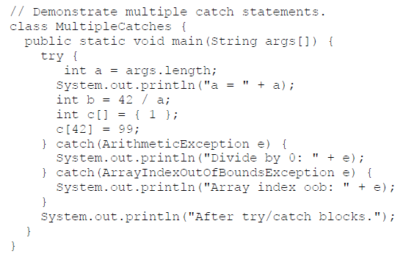
Multiple catch Clauses : Example 2

Slide 8
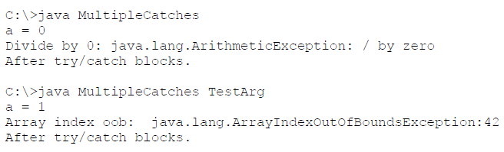
Multiple catch Clauses: Example 2
The output generated by running it both ways:

Slide 9
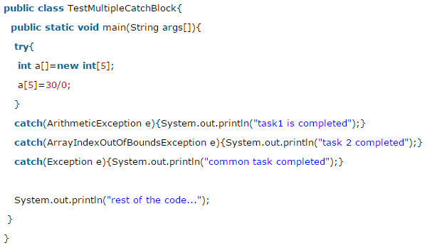
Multiple catch Clauses: Example 2
Output:
task1 completed
rest of the code...

Slide 10
Multiple catch Clauses
Rule 1: At a time only one Exception is occurred.
Rule 2: At a time only single catch block can be executed. After the execution of catch block control goes to the statement next to the try block.
Rule 3: When you use multiple catch statements, it is important to remember that exception subclasses must come before any of their super-classes.

Slide 11
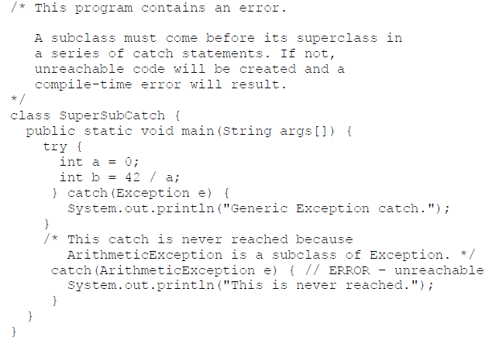
Multiple catch Clauses

Slide 12
Multiple catch Clauses
If you try to compile this program, you will receive an error message stating that the second catch statement is unreachable because the exception has already been caught.
Since ArithmeticException is a subclass of Exception, the first catch statement will handle all Exception-based errors, including ArithmeticException.
This means that the second catch statement will never execute. To fix the problem, reverse the order of the catch statements.

Slide 13
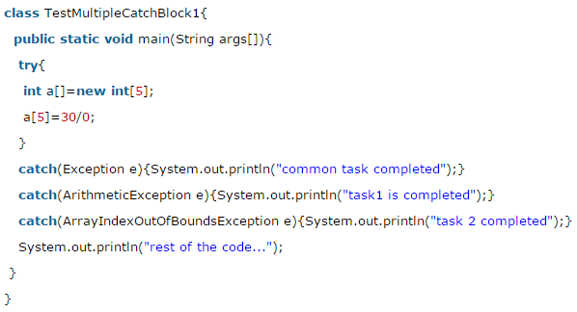
Multiple catch Clauses
Output:
Compile-time error
Because ArithmeticException and ArrayIndexOutOfBoundsException is a sub class of Exception

Slide 14
Nested try Statements
The try block within a try block is known as nested try block in java.
Why use nested try block:
Sometimes a situation may arise where a part of a block may cause one error and the entire block itself may cause another error. In such cases, exception handlers have to be nested.

Slide 15
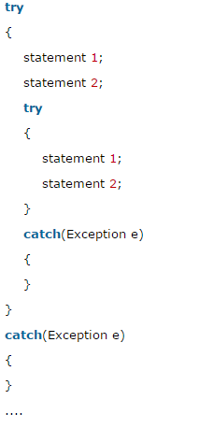
Syntax:

Slide 16
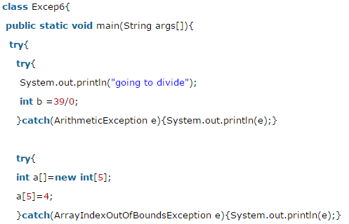
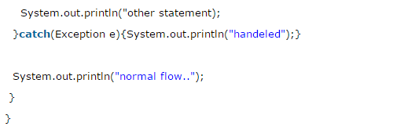

Slide 17
throw
So far, you have only been catching exceptions that are thrown by the Java run-time system.
However, it is possible for your program to throw an exception explicitly, using the throw statement.
The general form of throw is shown here:
throw exception;
Let's see the example of throw IOException.
throw new IOException("sorry device error”);

Slide 18
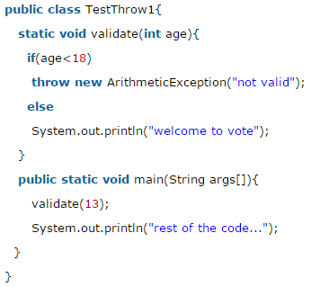
throw
Sample program that creates and throws an exception.
In this example, we have created the validate method that takes integer value as a parameter. If the age is less than 18, we are throwing the ArithmeticException otherwise print a message
Output:
Exception in thread main java.lang.ArithmeticException:not valid

Slide 19
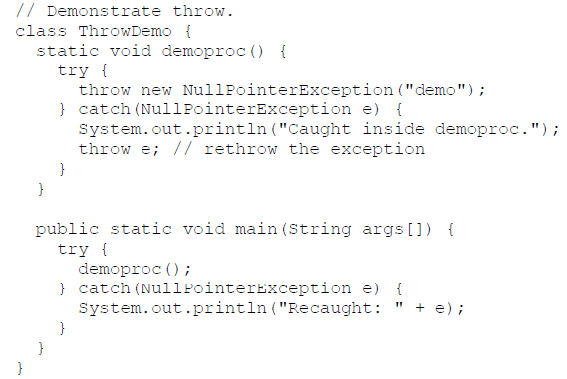
throw
Sample program that creates and throws an exception.

Slide 20
throw
This program gets two chances to deal with the same error. First, main( ) sets up an exception context and then calls demoproc( ).
The demoproc( ) method then sets up another exception-handling context and immediately throws a new instance of NullPointerException, which is caught on the next line.
The exception is then rethrown.
Here is the resulting output:
Caught inside demoproc.
Recaught: java.lang.NullPointerException: demo

Slide 21
throw
The program also illustrates how to create one of Java’s standard exception objects.
throw new NullPointerException("demo");
Here, new is used to construct an instance of NullPointerException.
Many of Java’s built-in run-time exceptions have at least two constructors: one with no parameter and one that takes a string parameter.
When the second form is used, the argument specifies a string that describes the exception. This string is displayed when the object is used as an argument to print( ) or println( ).

Slide 22
throws
If a method is capable of causing an exception that it does not handle, it must specify this behavior so that callers of the method can guard themselves against that exception.
You do this by including a throws clause in the method’s declaration.
A throws clause lists the types of exceptions that a method might throw.

Slide 23
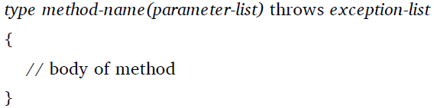
throws
This is the general form of a method declaration that includes a throws clause:
Here, exception-list is a comma-separated list of the exceptions that a method can throw.

Slide 24
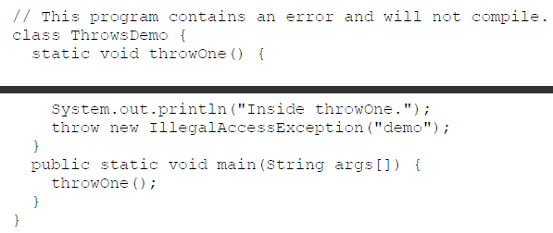
throws
Following is an example of an incorrect program that tries to throw an exception that it does not catch. Because the program does not specify a throws clause to declare this fact, the program will not compile.

Slide 25
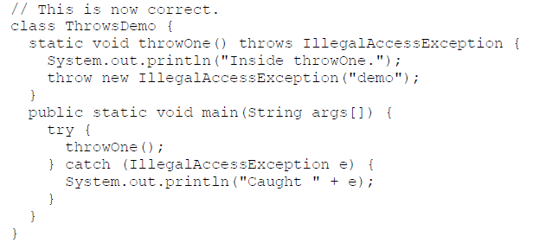
throws
To make this example compile, you need to make two changes. First, you need to declare that throwOne( ) throw IllegalAccessException. Second, main( ) must define a try / catch statement that catches this exception.
The corrected example is shown here:

Slide 26
throws
Here is the output generated by running this example program:
inside throwOne
caught java.lang.IllegalAccessException: demo

Slide 27
Checked and unchecked exception
Checked: are the exceptions that are checked at compile time. If some code within a method throws a checked exception, then the method must either handle the exception or it must specify the exception using throws keyword.
Unchecked are the exceptions that are not checked at compiled time. In C++, all exceptions are unchecked, so it is not forced by the compiler to either handle or specify the exception. It is up to the programmers to be civilized, and specify or catch the exceptions.
In Java exceptions under Error and RuntimeException classes are unchecked exceptions, everything else under throwable is checked.

Slide 28
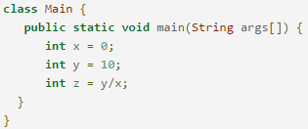
Checked and unchecked exception
Consider the following Java program. It compiles fine, but it throws ArithmeticException when run. The compiler allows it to compile, because ArithmeticException is an unchecked exception.

Slide 29
Java Exception propagation
An exception is first thrown from the top of the stack and if it is not caught, it drops down the call stack to the previous method, If not caught there, the exception again drops down to the previous method, and so on until they are caught or until they reach the very bottom of the call stack.
This is called exception propagation.

Slide 30
Java Exception (unchecked) propagation: Example
class TestExceptionPropagation1{
void m(){
int data=50/0;
}
void n(){
m();
}
void p(){
try{
n();
}catch(Exception e){System.out.println("exception handled");}
}
public static void main(String args[]){
TestExceptionPropagation1 obj=new TestExceptionPropagation1();
obj.p();
System.out.println("normal flow...");
}
}
Output:
exception handled
normal flow...

Slide 31
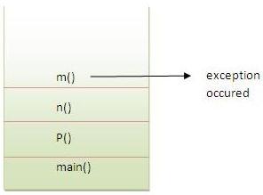
Java Exception (unchecked) propagation: Example
In the above example exception occurs in m() method where it is not handled, so it is propagated to previous n() method where it is not handled, again it is propagated to p() method where exception is handled.
Exception can be handled in any method in call stack either in main() method, p() method, n() method or m() method.

Slide 32
Checked exceptions are not propagated
class TestExceptionPropagation2{
void m(){
throw new java.io.IOException("device error");//checked exception
}
void n(){
m();
}
void p(){
try{
n();
}catch(Exception e){System.out.println("exception handeled");}
}
public static void main(String args[]){
TestExceptionPropagation2 obj=new TestExceptionPropagation2();
obj.p();
System.out.println("normal flow");
}
}
Output:
Compile Time Error

Slide 33
Java Exception propagation
Rule: By default Unchecked Exceptions are forwarded in calling chain (propagated).
Rule: By default, Checked Exceptions are not forwarded in calling chain (propagated).

Slide 34
Checked Exception can be propagated using throws
import java.io.IOException;
class Testthrows1{
void m()throws IOException{
throw new IOException("device error");//checked exception
}
void n()throws IOException{
m();
}
void p(){
try{
n();
}catch(Exception e){System.out.println("exception handled");}
}
public static void main(String args[]){
Testthrows1 obj=new Testthrows1();
obj.p();
System.out.println("normal flow...");
}
}
Let's see the example of java throws clause which describes that checked exceptions can be propagated by throws keyword.
Output:
exception handled normal flow...

Slide 35
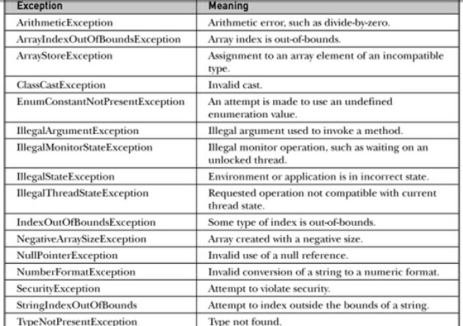
Java’s Built-in Exceptions
Inside the standard package java.lang, Java defines several exception classes.

Slide 36
Thank you

